Slide 1
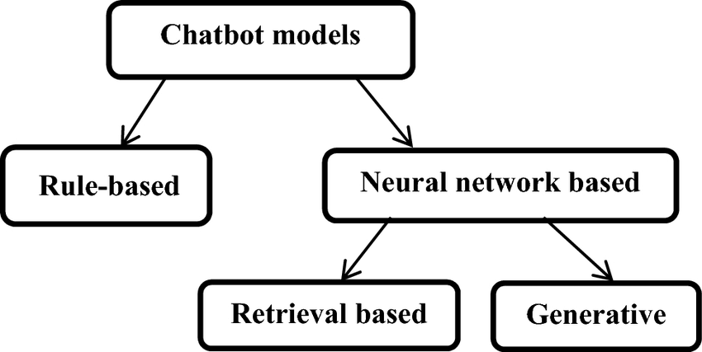
WHAT IS CHATBOT?
A chatbot is a computer program that simulates human conversation through voice commands or text chats or both. Chatbot, short for chatterbot, is an artificial intelligence (AI) feature that can be embedded and used through any major messaging applications.
TYPES

Slide 2
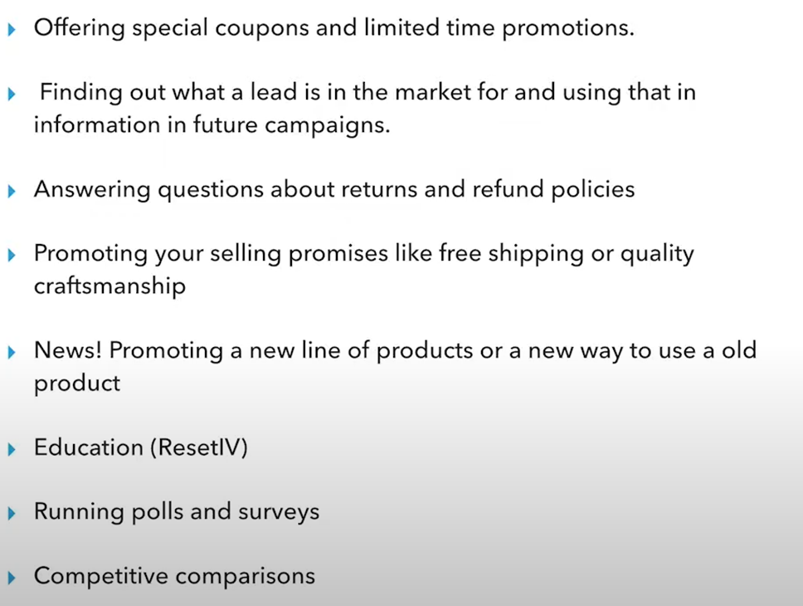
E-commerce Bot strategies (trending)

Slide 3
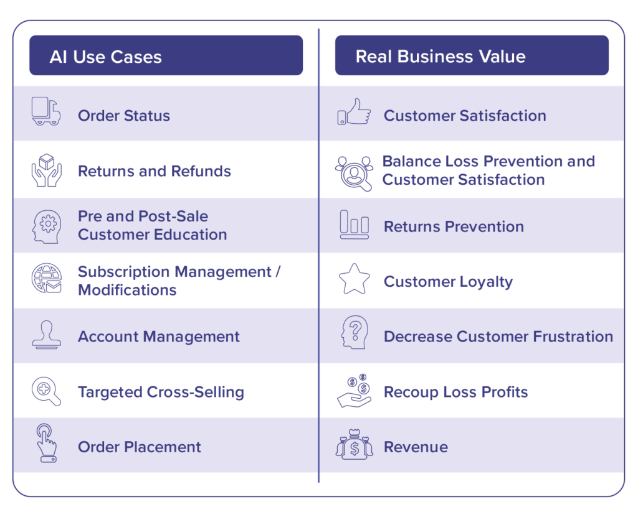

Slide 4
WEBSITE LINKS
1). https://www.abetterlemonadestand.com/ecommerce-chatbots/
Ecommerce brands succeeding with chatBots.
(Competitor chatBots)
2). https://www.netomi.com/ecommerce-chatbot
ChatBot capabilities and features.
(What make them special)
3). https://www.userlike.com/en/blog/chatbot-conversation-flow
chatBot conversation.
4). https://freshdesk.com/customer-support/customer-satisfaction-ai-chatbots-blog/
Self learning chatbot (AI NLP ).

Slide 5
SEPHORA
Sephora Color Match allows users to hold their camera up to any image or face and an algorithm will automatically detect and present the user with the identified shade, as well as other matching products from the Sephora line such as lipstick and eye makeup.
TOMMY HILFIGER
The chatbot invites viewers to engage directly by clicking a time-sensitive greeting that's overlaid upon the video. Viewers who respond to the offer can browse Tommy Hilfiger's latest products by answering a series of questions about fashion tastes and sizes.
EBAY
The virtual agent messenger bot helps shoppers find the best deals and products. Users text or snap pictures of items they are looking for (i.e. I want red Nike shoes) and the bot will ask questions to better understand what a person is looking for (sizing, budget, etc.) in order to narrow down the options.

Slide 6
How would you incorporate self-learn capabilities in your chatbot?
Chatbots work through two systems. The first type functions based on a set of rules, and the second type functions using machine learning.
Rule-Based Chatbots
Chatbots that function based on a set of rules are restrictive. They can only respond to specific commands rather than interpreting a user’s language. Rule-based chatbots are great if users are only expected to have simple queries that refer to a limited set of information. The personal finance app Digit, in the example above, uses rule-based chat since the user is only expected to ask a narrow set of questions about their account.
AI Chatbots(self learning)
Chatbots that function through machine learning use AI to handle a wide range of conversations and requests from users. Instead of only responding to specific commands, AI chatbots can interpret a user’s language to understand and meet their needs.
AI chatbots make sense if you want to handle complex queries and comments from users, such as a user asking for a product recommendation.

Slide 7
How to Measure Chatbot’s Performance & Effectiveness?
Chatbot Analytics Metrics
If you want to know the performance and effectiveness of your chatbot, you need to use chatbot metrics, including several parameters. The top 4 metrics are mentioned below for measuring the performance and effectiveness of chatbot.
After understanding how a chatbot works, you can measure its performance with the aid of chatbot analytics and metrics. You can use this KPI to track the response time, conversion rate, and efficiency to improve the chatbot’s performance significantly.
The key metrics you need to evaluate on the user’s side are as follows:
# 1 – Total Users
The total number of chatbots users is one of the main KPIs you should analyze. It helps capture insights on how many customers are using your chatbot. With this, you will also get to know the overall impact and chatbot success. You can categorize your chatbot users into three categories such as active users, engaged users and new users.
#2 – Active Users
Active users who have repeated conversations with your chatbot regularly. The active user means your users are happy using your bot and keep returning to your business.

Slide 8
#3 – New Users
The users’ number helps businesses get real-time information into the chatbot’s overall popularity, which is a great parameter of its success. New users are your prospective targets and how your bot helps them and they are ready to converse again.
#4 – Numbers of Bot Sessions Initiated
The chatbot metric determines the interaction between users and chatbot. It monitors and provides insights into its ability to engage in a conversation. The number of interactions indicates accurately how far down the conversational decision tree the user made. So, assessing whether the sentiments of this KPI are positive or negative is not an exact issue.
#5 – Bounce Rate
Bounce rate means total visitors who visit web pages and leave without interacting with your chatbot. In simple terms, people who navigate away after visiting just one page on your website. Having a high bounce rate means there is something wrong with your website design or content. It impacts the customer experience thanks to chatbot KPI.

Slide 9
Questionnaire
Hey! How you doing ?
Just wondering what are you looking for?
(knowing specific choices for specific cust.)
What for you is the most important selling pomises. (free shipping , quality craftmanship etc.)
Choose your fav. one . And do tell us why? (If a cust. wants this or that shopping. We can use these as insights for futher investing and ordering future stocks. )
confused ?? Go on with our fashion survey.
(Product recommendation)
How bout a color match?( allowed customers to find the best makeup shade for their skin tone and even recommend shades based on other objects like flowers or clothes.)
Which is your fav. Actor/actress wardrobe?

Slide 10
Need a personal shopper? (personal shopper, offering personalized product advice and answering questions related to fit, style or suitability)

Slide 11
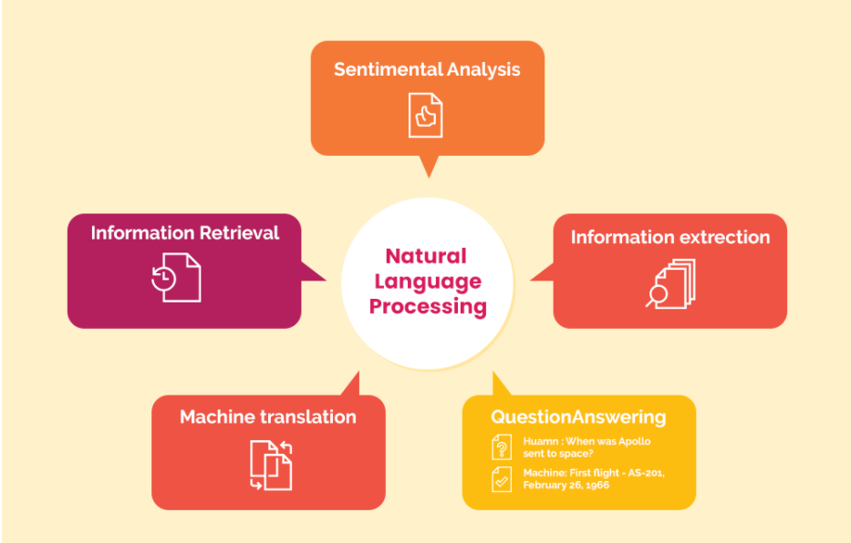
How To Build NLP WhatsApp Chatbot With Dialogflow?
1). NATURAL LANGUAGE PROCESSING
NLP is a concept based on deep-learning that enables computers to make sense of human language and gather meaning from inputs given by users. In the context of chatbots, NLP plays a key role in assessing the intent of the query asked by the users, followed by creating appropriate responses based on a contextual analysis similar to that in human interaction.
NLP makes it possible for software program/non-human entity to comprehend human language and respond accordingly. With NLP, you can appropriately train your chatbot on the different interactions it will go through to allow it to streamline the responses as per the intent of the query.

Slide 12
2). DIALOGFLOW
Dialogflow is a natural language understanding platform used to design and integrate a conversational user interface into mobile apps, web applications, devices, bots, interactive voice response systems and related uses.
(https://youtu.be/0SDfi3JvacE)
3). WATSAPP BUSINESS API’s
4). DATABASES
Like most applications, the chatbot is also connected to the database. The knowledge base or the database of information is used to feed the chatbot with the information required to give a suitable response to the user.

Slide 13
QUESTIONAIRE
What database we will be using and what information will be stored in that?
(like the whole conversation or just the specifics. )
Which platform do we need to use to connect the chatBot with watsapp from like Wotnot , Twilio or any other? (or we’ll be using watsapp business API?)
We’ll be needing a number to implement watsapp chatbot.
Brief of integration process? (specified tools and platforms to be used)

